Slide 1



Global Academy of Technology
Rajarajeshwari Nagar,Bengaluru-560098
Department of Electronics and Communication Engineering
Main Project Phase-II (22ECEP65)
Review-2 Presentation
on
“Crowd Density Analysis using deep learning”
Presented By:
Student Name (USN)
Ankith R (1GA22EC011)
Bharath C (1GA22EC021)
Karthik R (1GA22EC065)
Paramesha VN (1GA23EC409)
Batch Number:
A8
Under The Guidance of:
Tilak Kumar L
Assistant Professor
Dept. of ECE, GAT

Slide 2
CONTENTS
Introduction
Problem Statement
Literature Survey
Objectives
Methodology
Results
Advantages and Disadvantages
Applications
Conclusion
Future Work
References

Slide 3

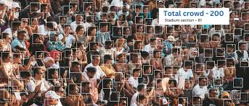
INTRODUCTION
Crowd density analysis is essential for ensuring public safety and effective crowd management in areas with high foot traffic. Traditional methods often lack accuracy and scalability in real-time scenarios. This project uses deep learning techniques, particularly Convolutional Neural Networks (CNNs), to automatically estimate crowd density from images or video. The system provides accurate, real-time insights, aiding in better decision-making and situational awareness.

Slide 4
PROBLEM STATEMENT
Effective crowd management is challenging with traditional methods that are often manual, slow, and inaccurate. These limitations can pose serious safety risks in densely populated areas. This project aims to develop a deep learning-based system that analyzes images or video feeds to estimate crowd density in real-time. By leveraging convolutional neural networks (CNNs), the system provides accurate, automated insights for improved safety and decision-making.

Slide 5
LITERATURE SURVEY
Sl. No. | Title | Journal/Conference | Year | Contributions | Limitations
1 | Integrating Explainable Artificial Intelligence with Advanced Deep Learning Model for Crowd Density Estimation in Real-World Surveillance Systems | IEEE Access | 2025 | Introduces an advanced deep learning model integrated with explainable AI for real-time crowd density estimation in surveillance systems. | Limited scalability in highly dynamic environments.
2 | An Analysis Approach for Crowds with Varying Density and Complexity Using Image Data | 29th International Conference on Information Technology (IT), Zabljak, Montenegro | 2025 | Proposes a method for analyzing crowds with varying density and complexity using image data, enhancing understanding of crowd behaviors. | May require extensive computational resources for processing complex images.
3 | A Novel Approach for Crowd Analysis and Density Estimation by Using Machine Learning Techniques | International Conference on Intelligent Systems for Cybersecurity (ISCS) | 2024 | Develops a machine learning-based approach for crowd analysis and density estimation, focusing on accuracy and efficiency. | Potential challenges in handling noisy or incomplete data.

Slide 6
Sl. No. | Title | Journal/Conference | Year | Contributions | Limitations
4 | Deep Learning in Crowd Analysis: A Survey of Current Research Trends | 17th International Conference on Electronics Computer and Computation (ICECCO), Kaskelen, Kazakhstan | 2023 | Provides a comprehensive survey of deep learning techniques in crowd analysis, highlighting recent advancements and trends. | Limited focus on practical implementation challenges.
5 | Design of Artificial Intelligence Driven Crowd Density Analysis for Sustainable Smart Cities | IEEE Access | 2024 | Presents a design for AI-driven crowd density analysis tailored for sustainable smart cities, emphasizing real-time data processing. | Scalability issues in large urban areas with diverse crowd behaviors.
6 | Bigdata Enabled Realtime Crowd Surveillance Using Artificial Intelligence And Deep Learning | IEEE International Conference on Big Data and Smart Computing (BigComp), Jeju Island, Korea | 2021 | Explores the integration of big data analytics with AI and deep learning for real-time crowd surveillance. | High dependency on data quality and availability.

Slide 7
OBJECTIVES
To develop a deep learning model capable of accurately estimating crowd density from images or video feeds using convolutional neural networks (CNNs).
To implement real-time processing for continuous monitoring of crowd density in dynamic environments.
To evaluate the model's performance across different scenarios and crowd conditions to ensure robustness and accuracy.
To create a user-friendly interface or dashboard for visualizing crowd density data and supporting decision-making in real-world applications.

Slide 8
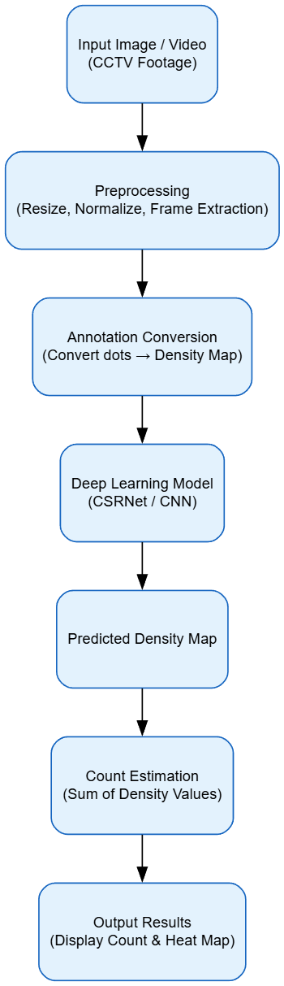
METHODOLOGY
Figure 2
Flow Chart of Crowd density analysis

Slide 9
Crowd images or video frames are collected from CCTV or public datasets, then resized, normalized, and preprocessed for analysis.
Ground-truth annotations marking each person are converted into smooth density maps using Gaussian filters for accurate training data.
A deep learning model such as CSRNet is trained to learn the relationship between input images and their corresponding density maps using Mean Squared Error loss.
The trained model is tested on new images to predict density maps, and the total crowd count is obtained by summing all pixel values, which is visualized as a heat map showing crowd distribution.

Slide 10
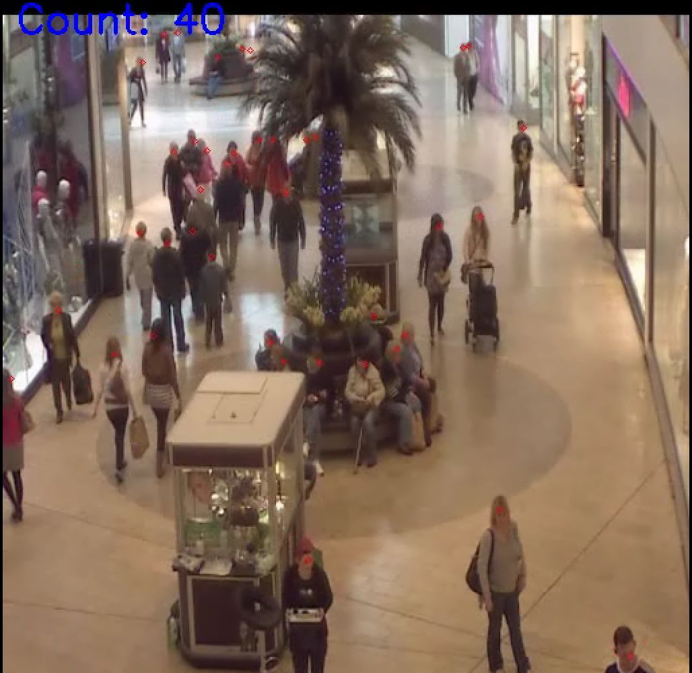
RESULTS

Slide 11
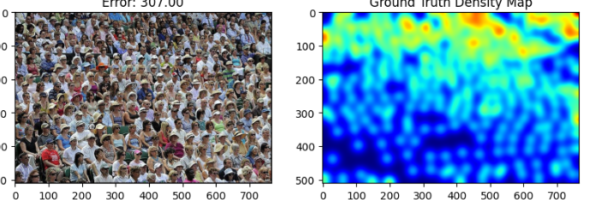
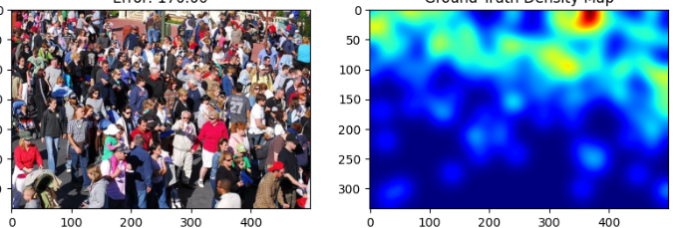

Slide 12
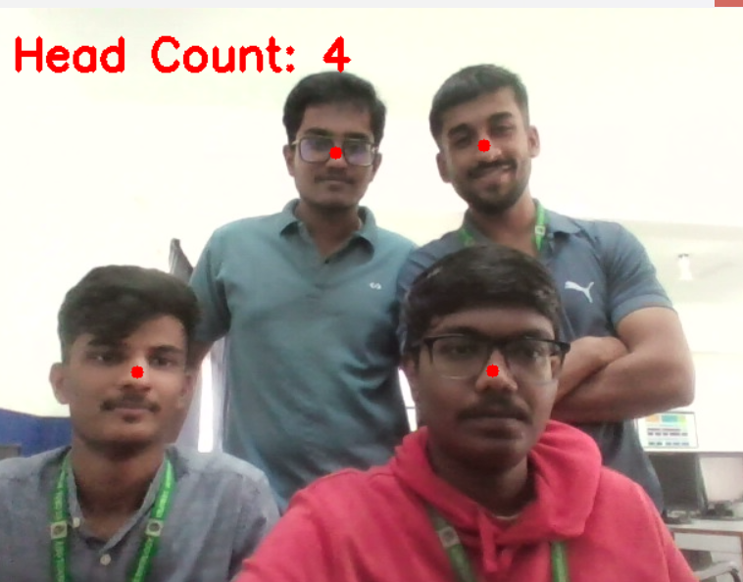

Slide 13
Advantages
Gives more accurate crowd counting than manual methods.
Can work in real-time to monitor crowds from video.
Handles crowded or overlapping people better than normal detection methods.
Useful for safety and crowd control during big events.
Can be used in different places by training with new data.
Shows heat maps that make it easy to see where the crowd is dense.

Slide 14
Disadvantages
Needs a large amount of training data with proper labeling.
Takes more time and high processing power to train and run.
May not work well in poor light or bad weather conditions.
Results depend on camera quality and position.
A model trained in one place may not work well in another location.
Slow in real-time if system hardware is weak.

Slide 15
Applications
Public Safety: Used to watch and control large crowds in places like festivals or rallies to avoid accidents.
Smart Cities: Helps city officials understand how people move in busy areas like malls or parks.
Transport Areas: Used at airports, railway stations, and bus stops to manage passenger crowds.
Emergency Situations: Helps find crowded or dangerous areas quickly during disasters for rescue.
Event Management: Used to control the number of people and keep events safe in stadiums or concerts.

Slide 16
Conclusion
Crowd density analysis using deep learning provides an effective and reliable way to estimate and monitor crowd levels in real time. By using models like CSRNet, it can accurately predict crowd distribution from images or videos and generate heat maps that help in better visualization and decision-making. This technology plays an important role in public safety, event management, and smart city applications by preventing overcrowding and improving surveillance. Overall, it offers a modern and intelligent solution for efficient crowd monitoring and management.

Slide 17
Future Scope
Real-Time Use: Can be improved to work faster for live crowd monitoring.
Better Accuracy: Future models can give more correct crowd counts.
Multi-Camera Use: Can combine views from many cameras for better results.
Smart City Link: Can connect with city systems for automatic crowd control and safety.

Slide 18
REFERENCES
[1]Alotaibi, Sultan Refa, et al. "Integrating Explainable Artificial Intelligence with Advanced Deep Learning Model for Crowd Density Estimation in Real-world Surveillance Systems." IEEE Access (2025).
[2] M. M. Menevse, M. Gozet, A. E. Yilmaz and M. Karakose, "An Analysis Approach for Crowds with Varying Density and Complexity Using Image Data," 2025 29th International Conference on Information Technology (IT), Zabljak, Montenegro, 2025, pp. 1-4, doi: 10.1109/IT64745.2025.10930264.
[3] Kamra, Vikas, et al. "A Novel Approach for Crowd Analysis and Density Estimation by Using Machine Learning Techniques." 2024 International Conference on Intelligent Systems for Cybersecurity (ISCS). IEEE, 2024.

Slide 19
[4]M. Ibrahim and C. Turan, "Deep Learning in Crowd Analysis: A Survey of Current Research Trends," 2023 17th International Conference on Electronics Computer and Computation (ICECCO), Kaskelen, Kazakhstan, 2023, pp. 1-3.
doi:10.1109/ICECCO58239.2023.10147135
[5]S. Alsubai et al., "Design of Artificial Intelligence Driven Crowd Density Analysis for Sustainable Smart Cities," in IEEE Access, vol. 12, pp. 121983-121993, 2024.
doi:10.1109/ACCESS.2024.3390049
[6] L. Rajendran and R. Shyam Shankaran, "Bigdata Enabled Realtime Crowd Surveillance Using Artificial Intelligence And Deep Learning," 2021 IEEE International Conference on Big Data and Smart Computing (BigComp), Jeju Island, Korea (South), 2021, pp. 129-132, doi: 10.1109/BigComp51126.2021.00032.

Slide 20
THANK YOU

